Slide 1

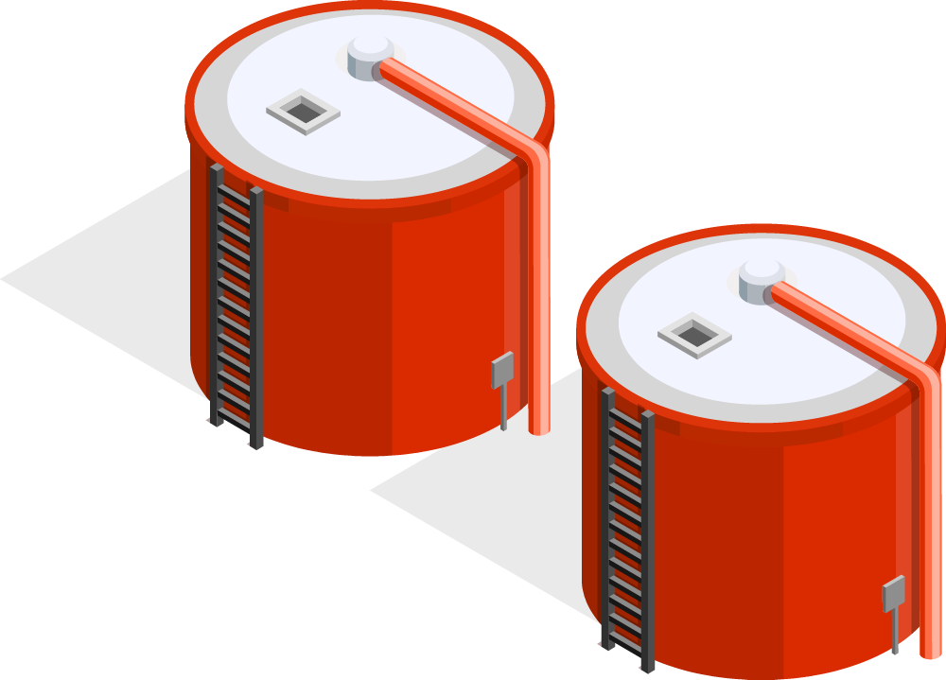
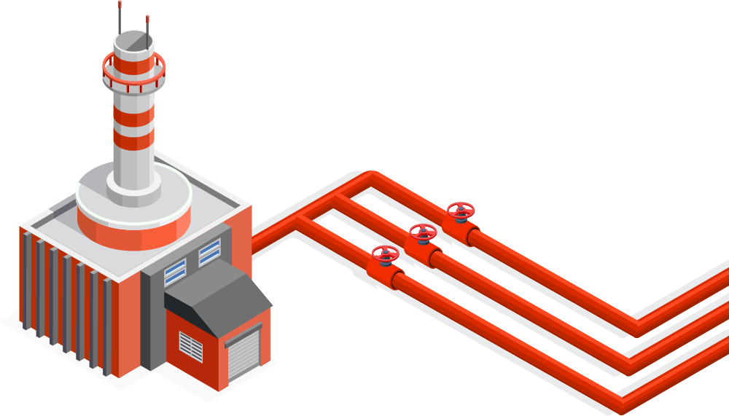
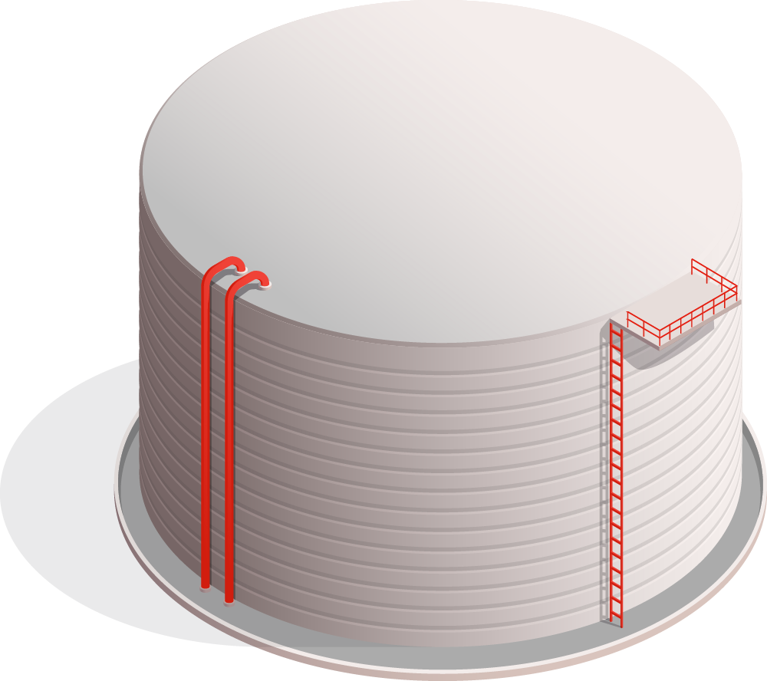
Predictive Analysis of Global Oil Consumption
P
Understanding Trends and Predicting the Future of Oil Consumption
Khaled Almansour – 221110083
Naif Aba Alrous – 222110926

Slide 2

Introduction
01
Global Oil Consumption & Reserves Analysis

Slide 3
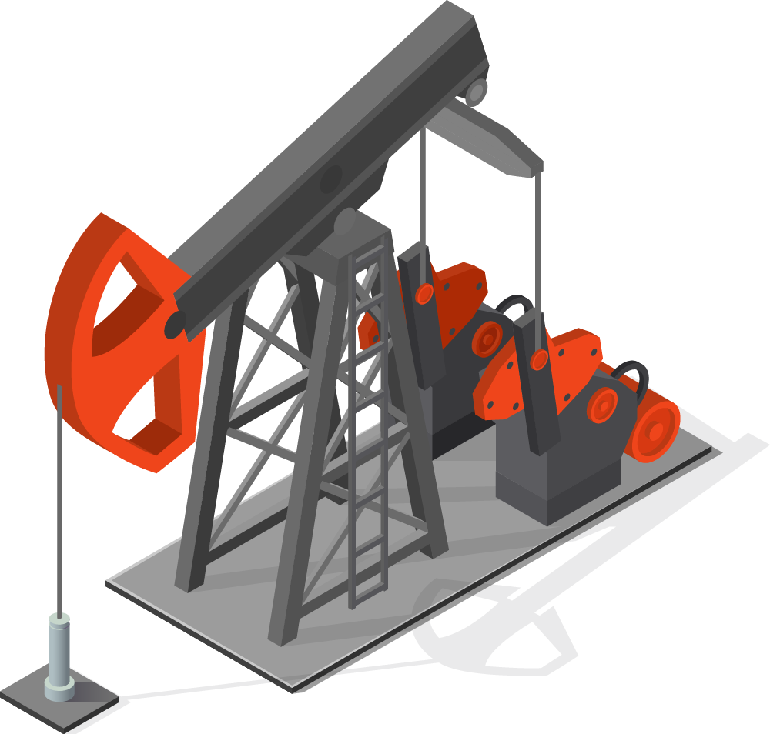
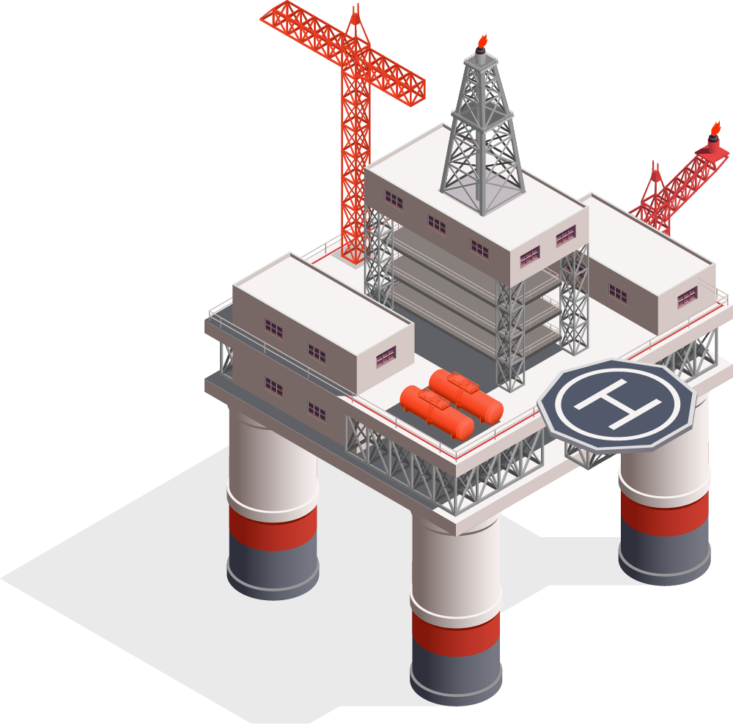
Global Oil Consumption & Reserves Analysis
Oil consumption and reserves are essential for understanding global energy use and sustainability.
This project predicts future consumption trends, providing countries with insights into when they might need to consider transitioning to sustainable energy sources.
The analysis provides key insights for policy-makers to make informed decisions about energy planning.

Slide 4
Problem
Statement
02
Motivation Behind the Analysis

Slide 5
Motivation Behind the Analysis
Forecast future oil consumption trends for each country using historical data.
Understand the relationship between oil consumption and reserves.
Address key research questions:
How can historical data predict future oil consumption trends?
How do oil reserves and consumption change over time, and what patterns indicate a shift towards cleaner energy?
Can we identify countries likely to switch to renewable energy based on the data?

Slide 6
Data
Overview
03
Data Sources and Coverage

Slide 7
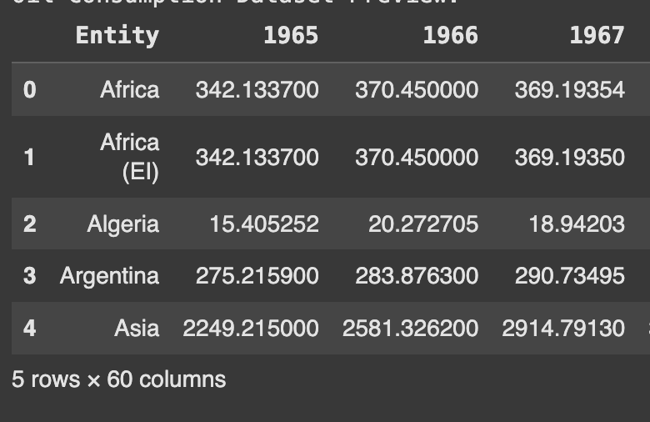
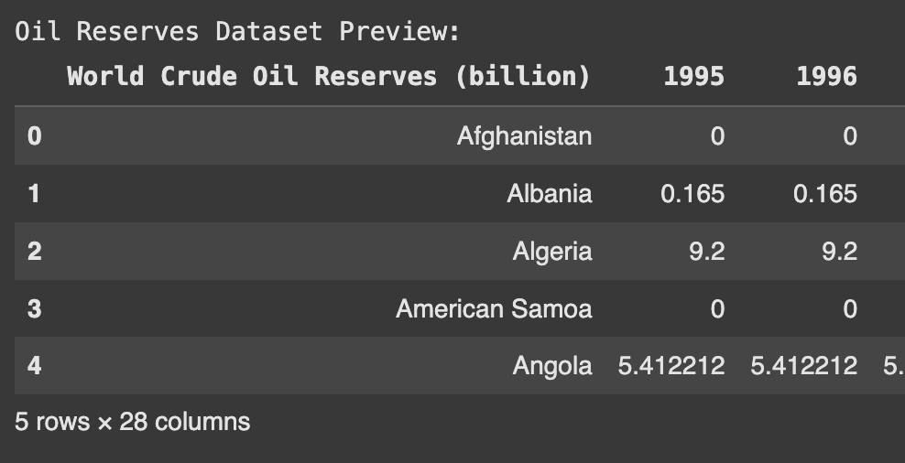
Data Sources and Coverage
Datasets used:
Oil Consumption: Data from 1965 - 2023:
Oil Consumption: Data from 1965 - 2023:
1965
1995
2023

Slide 8
Data Cleaning & Preparation
04
Data Cleaning and Alignment

Slide 9
Data Cleaning and Alignment
Handled missing Values
Merging Tables
Alignment
Handled missing values in the datasets to ensure accuracy.
Merged the oil consumption and reserves datasets for overlapping years to align the data.
This alignment was critical to ensure consistency in analysis and modeling.

Slide 10
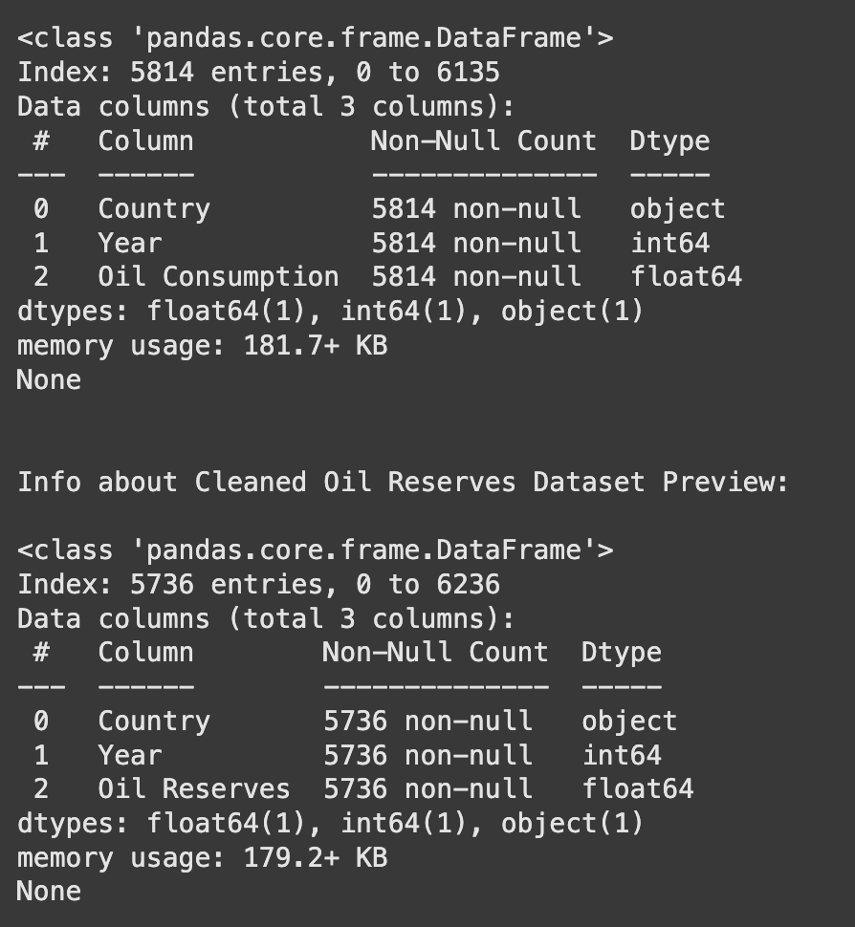
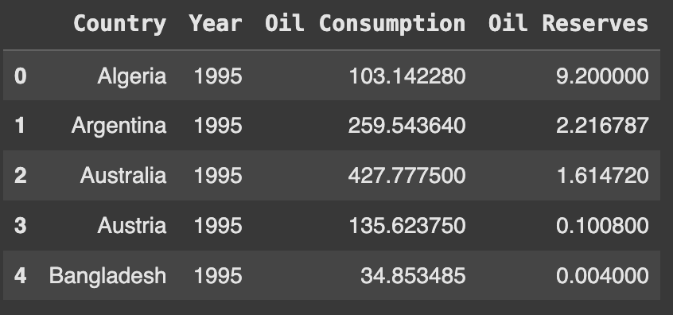
Handled missing Values
Merging Tables
Alignment
Handled missing values in the datasets to ensure accuracy.
Merged the oil consumption and reserves datasets for overlapping years to align the data.
This alignment was critical to ensure consistency in analysis and modeling.

Slide 11
Exploratory
Data Analysis (EDA)
05
Understanding the Trends

Slide 12
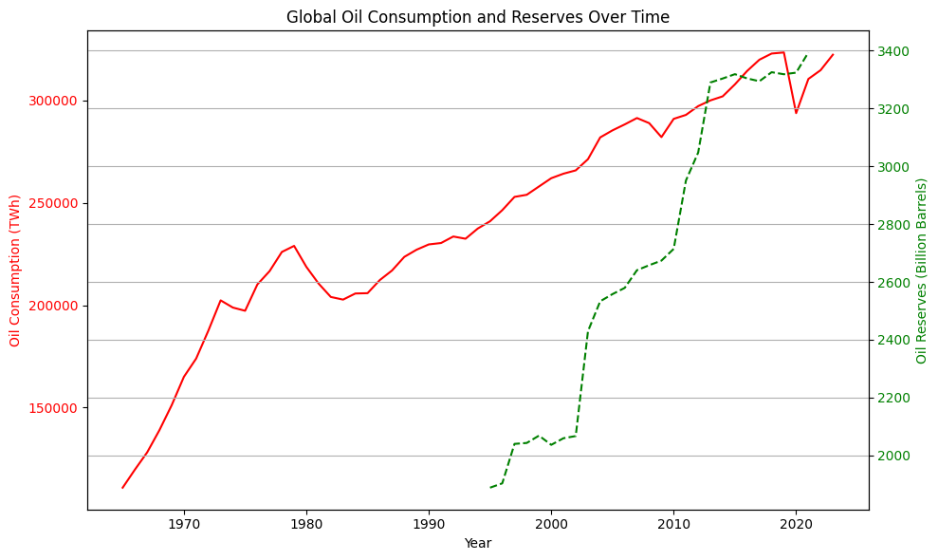
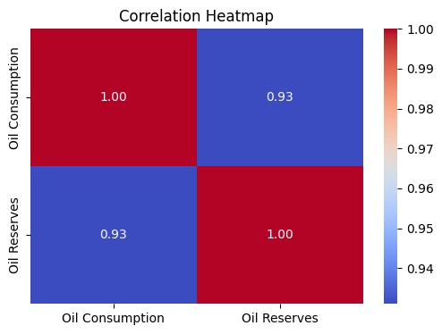
Understanding the Trends
Analysis of historical trends in oil consumption and reserves.
Identified correlations between consumption and reserves data.
Key insights into how consumption varies across the overall global trends.

Slide 13
Predictive
Modeling Approach
06
Modeling Oil Consumption

Slide 14
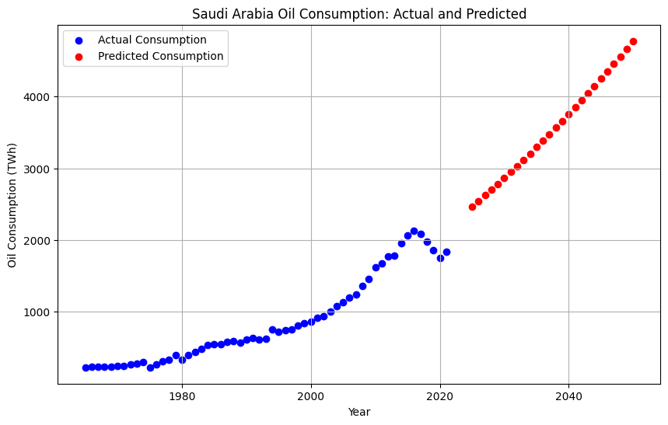
Modeling Oil Consumption
Used Polynomial Regression with a degree of 2 to predict future oil consumption trends.
Cross-validation was performed to assess the accuracy and reliability of the model.
Polynomial Regression was chosen because it could capture non-linear trends effectively in the data.

Slide 15
Predictive
Results and Insights
07
Country-Wise Prediction & Key Insights

Slide 16
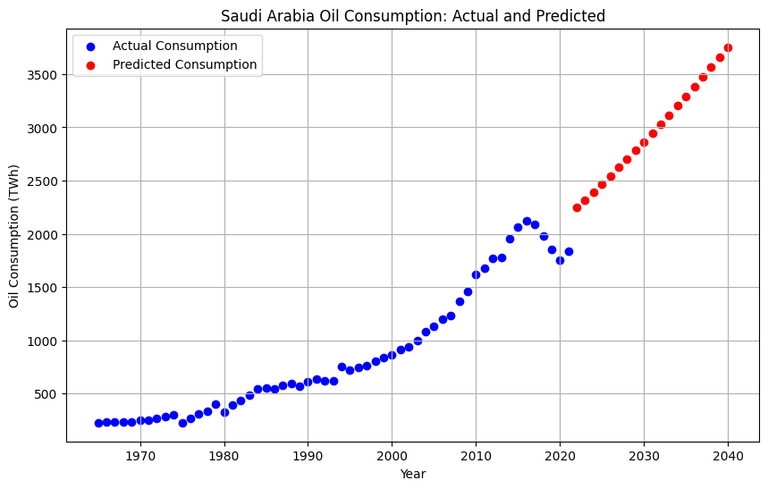
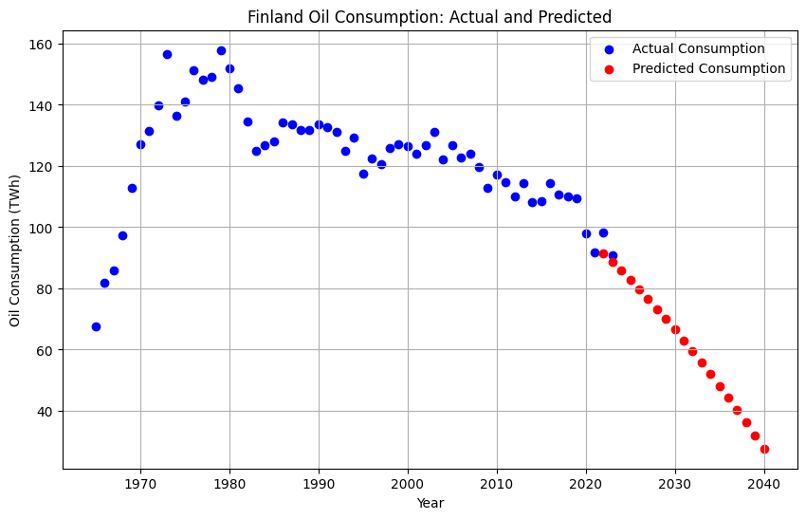
Modeling Oil Consumption
Predictions were made for Saudi Arabia, and Finland until 2040.
Insights indicate a continuous increase in consumption trends for Saudi Arabia, but decreasing in Finland indicating changing to sustainable energy.
The model is limited in predicting reserves trends due to the shorter time span of available data.

Slide 17
Limitations
of the Prediction Model
08
Challenges and Limitations

Slide 18
Challenges and Limitations
The model only considers country and year as features, excluding critical factors such as economic conditions, geopolitical events, or pandemics, For Example COVID-19 in 2019.
The absence of additional features like GDP, technological advancements, and policy changes limits the model's accuracy and predictive power.
Including these features will make the predictive model more usable and realistic to be used to countries

Slide 19
Research Questions
How can historical data predict future oil consumption trends?
How do oil reserves and consumption change over time, and what patterns indicate a shift towards cleaner energy?
Can we identify countries likely to switch to renewable energy based on the data?

Slide 20
Thank you

